Slide 1


MLNSD
VILLAMIN WOOD AND IRON WORKS SYSTEM

Slide 2

PROBLEM STATEMENT
Villamin Wood and Iron Works has been doing the business since 1983. In its span, it has been facing challenges and problems, specifically in customer reach and sales. The following are the challenges the company faces:​​
There is no chance of obtaining new customers, which affects the company's revenue.​
Their company sales decreased by 30% after the pandemic due to pending and shutdown operations of more than five months.
Presented By: Dale Joshua Domingo

Slide 3
GOALS AND OBJECTIVES
Presented By: Dale Joshua Domingo
To boost the number of customers by creating a convenient alternative for their Facebook page through our system.
To create features for the system which will improve the time it takes for transactions to complete.

Slide 4
STAKEHOLDER REGISTER
Presented By: Leigh Curtis Camara
Name | Position | Internal / External | Project Role | Contacts
Manuel Villamin Jr. | Project Sponsor | Internal, External | Project Sponsor | villaminmcverv@gmail.com
Sofia Villamin | Project Owner | Internal | Internal User of the System | srvillamin@student.apc.edu.ph
Mabelle Aspeli | Project Manager | Internal | Internal User of the System and Proofreader | mtaspeli@student.apc.edu.ph
Nathaniel Sison | Developer | Internal | System Developer | nmsison@student.apc.edu.ph
Leigh Camara & Ludwig Marco Angeles | Quality Assurance | Internal | Internal User of the System | lbcamara2@student.apc.edu.ph ltangeles@student.apc.edu.ph
Dale Joshua Domingo | Project/System Tester | Internal | Internal User and Fixer of the System | dbdomingo@student.apc.edu.ph
Villamin Wood and Iron Works Manager | Manager, Customer | External | External User of the system | villaminwoodworks@gmail.com

Slide 5
WORK BREAKDOWN STRUCTURE
Click here!
Presented By: Mabelle Aspeli

Slide 6
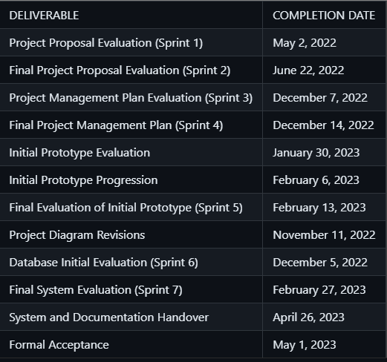
PROJECT DELIVERABLES AND MILESTONES
Presented By: Mabelle Aspeli

Slide 7
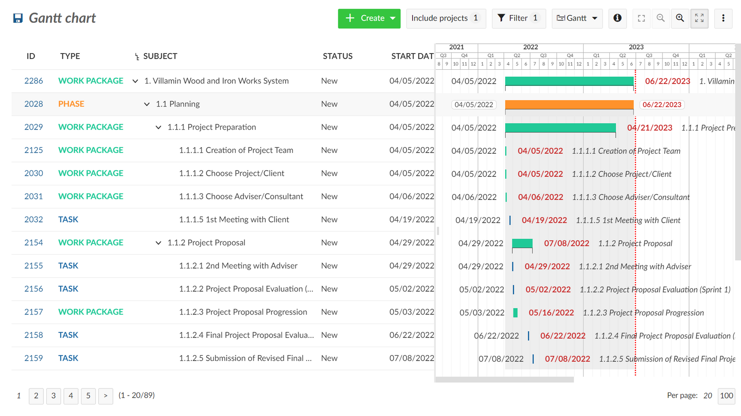
SCHEDULE GANTT CHART SUMMARY
Presented By: Mabelle Aspeli

Slide 8
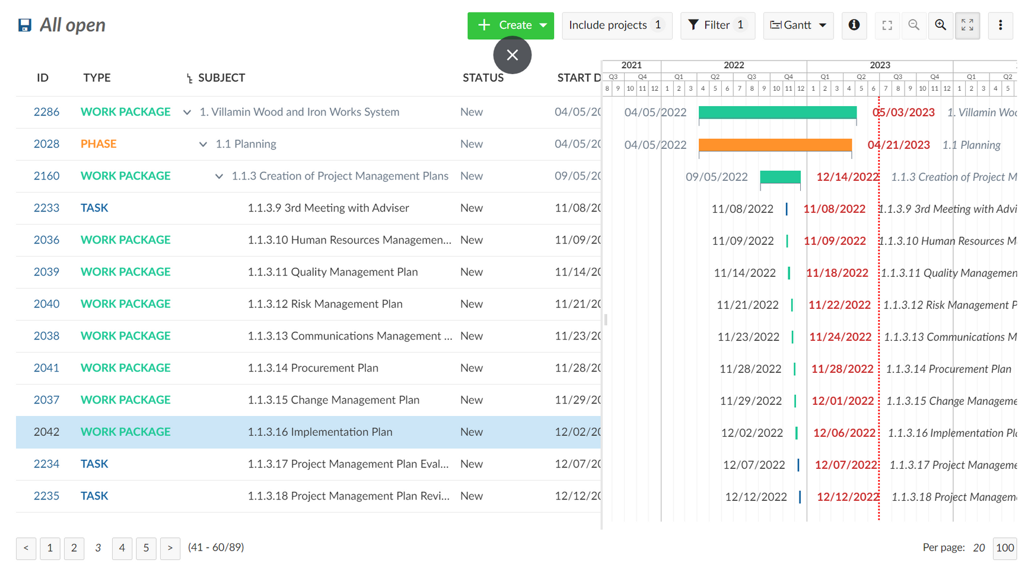
SCHEDULE GANTT CHART SUMMARY
Presented By: Mabelle Aspeli

Slide 9
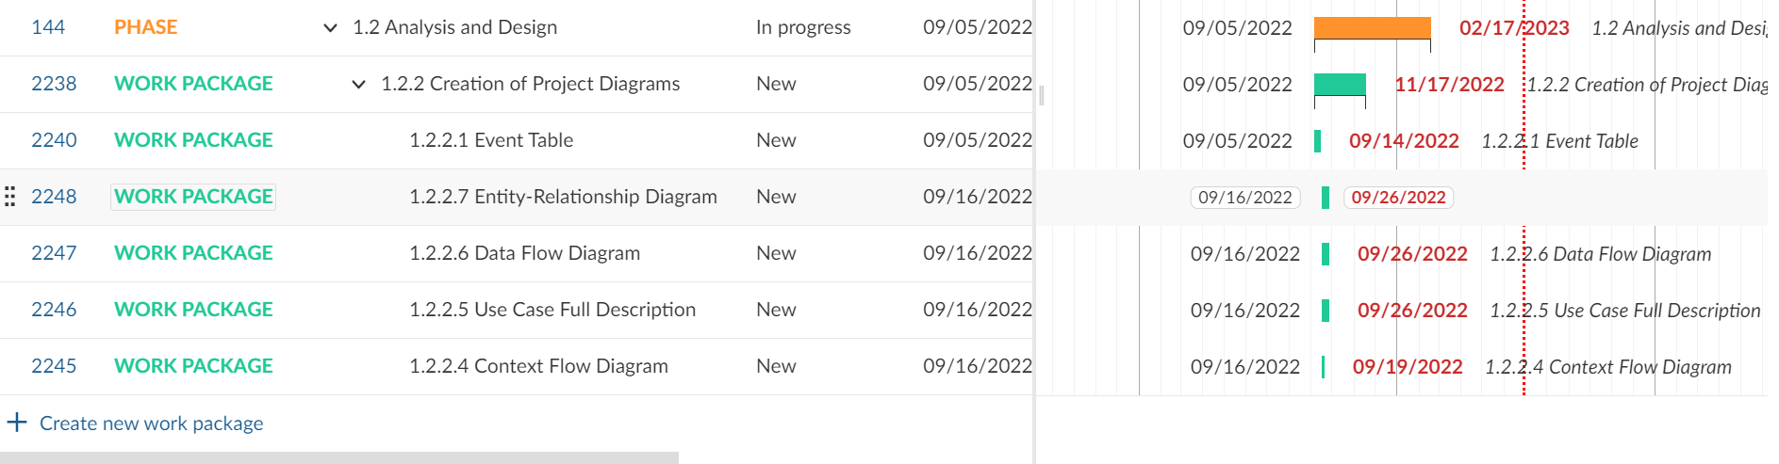
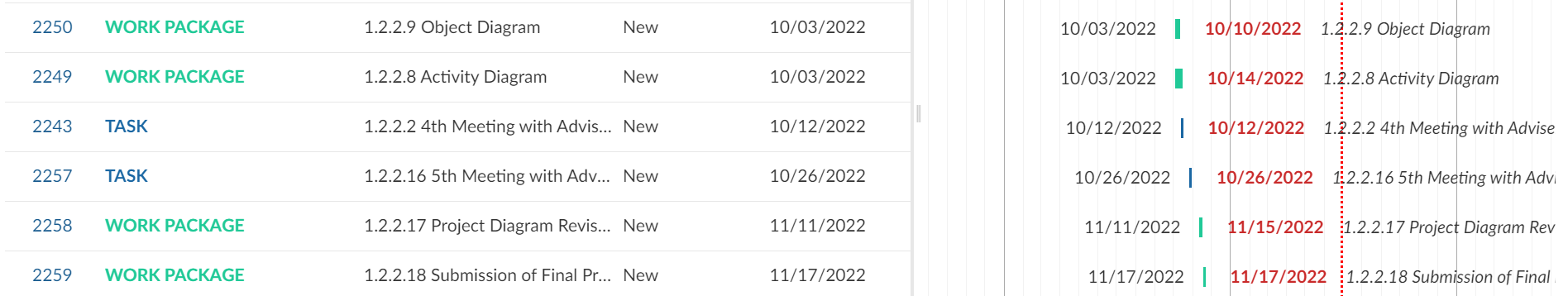
SCHEDULE GANTT CHART SUMMARY
Presented By: Mabelle Aspeli

Slide 10
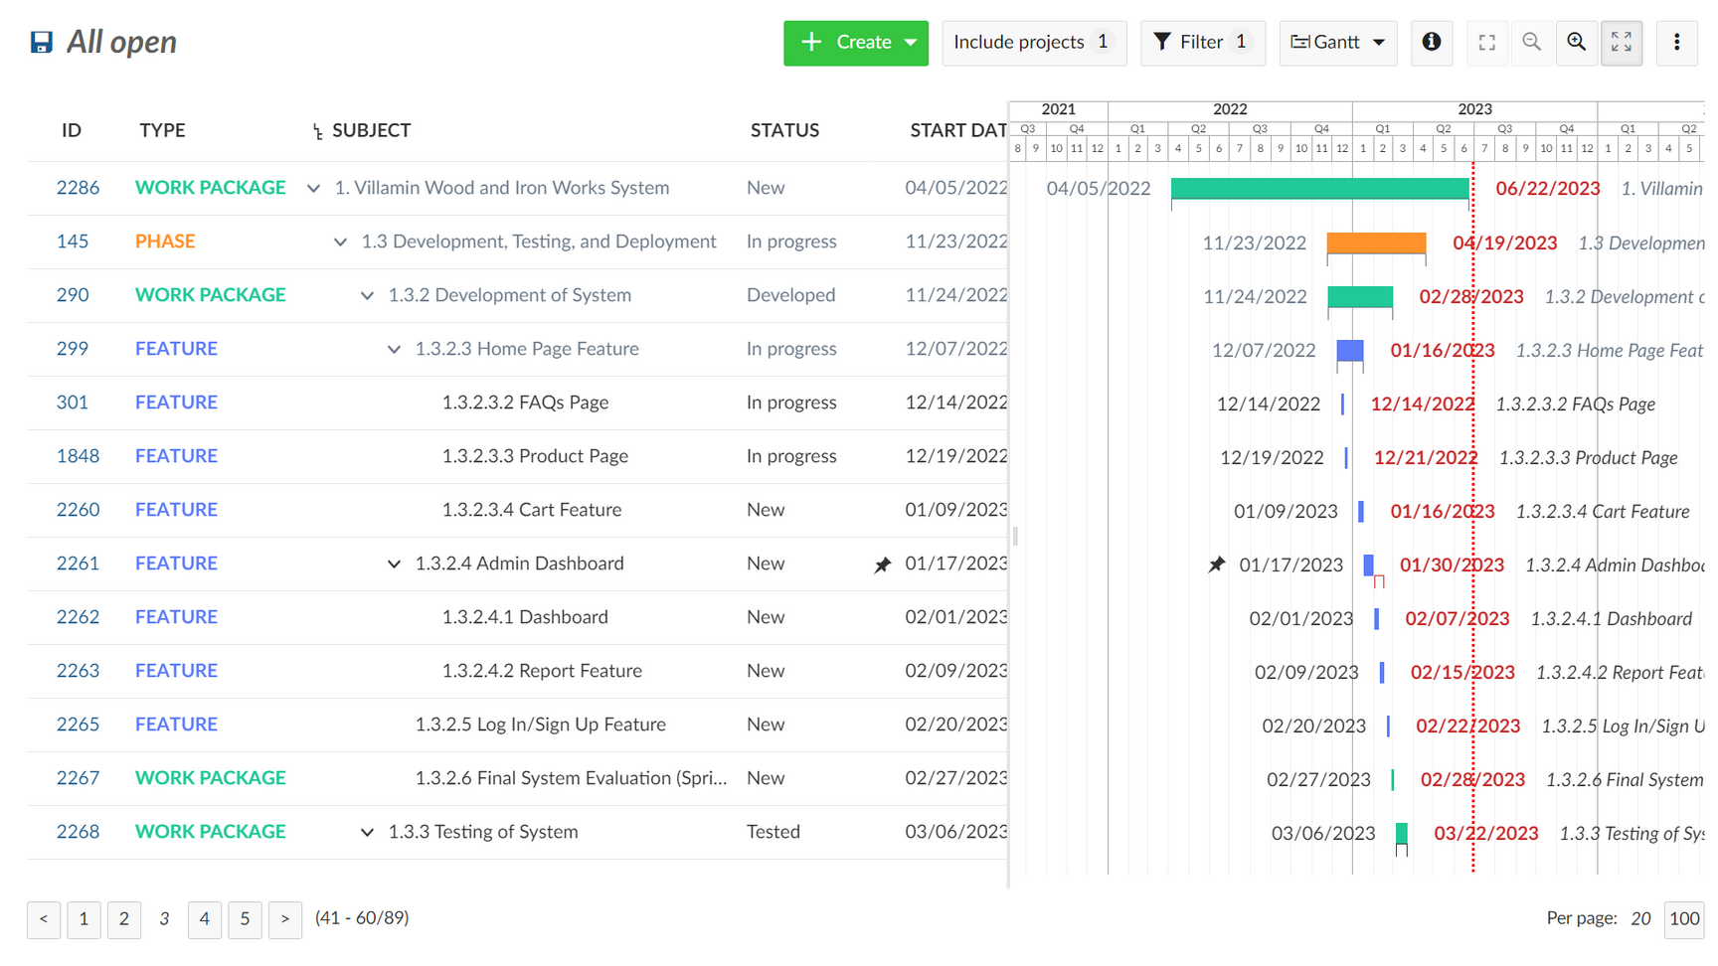
SCHEDULE GANTT CHART SUMMARY
Presented By: Mabelle Aspeli

Slide 11
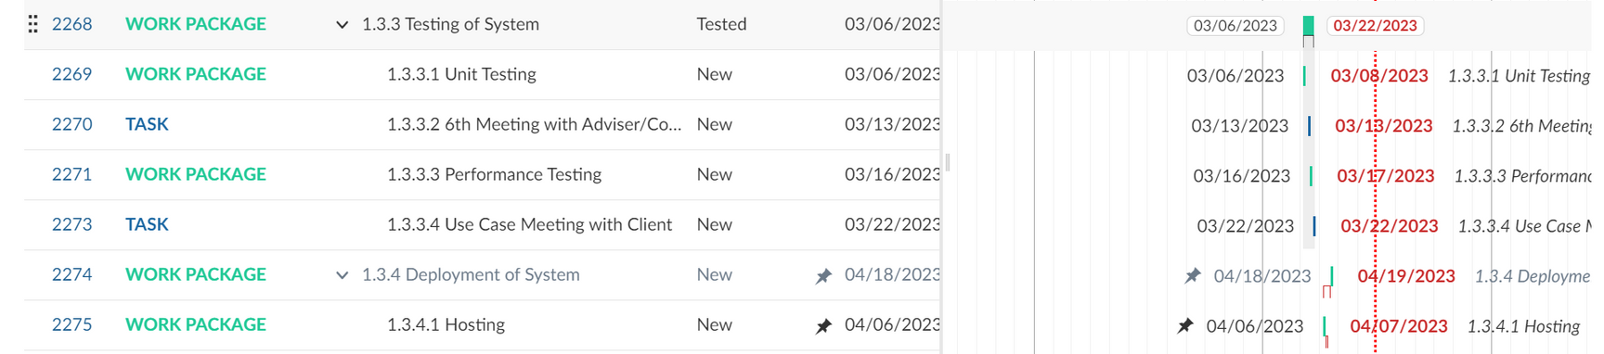
SCHEDULE GANTT CHART SUMMARY
Presented By: Mabelle Aspeli

Slide 12
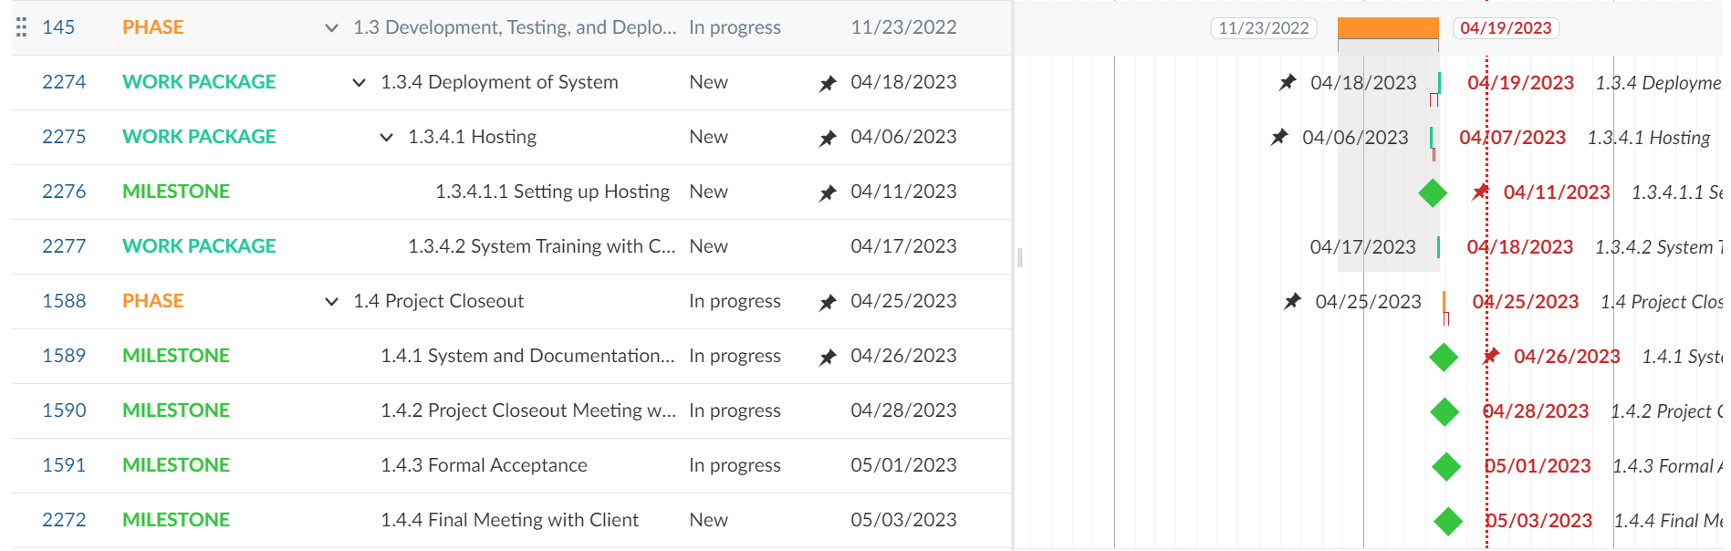
SCHEDULE GANTT CHART SUMMARY
Presented By: Mabelle Aspeli

Slide 13
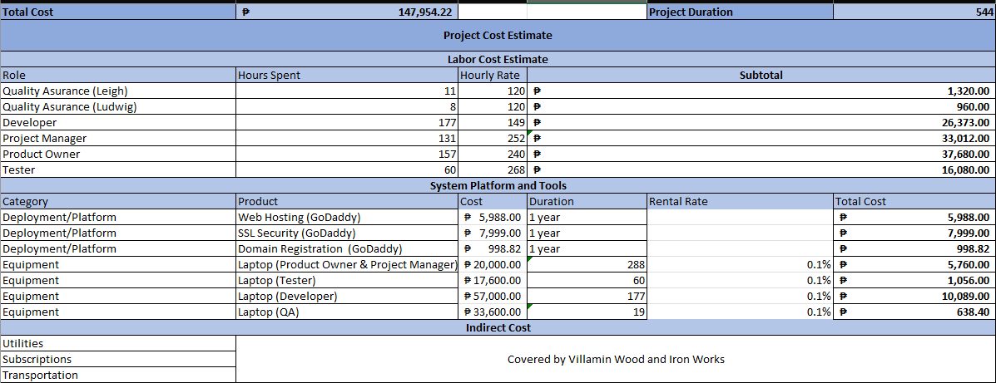
DETAILED COST ESTIMATE
Presented By: Nathaniel Sison

Slide 14
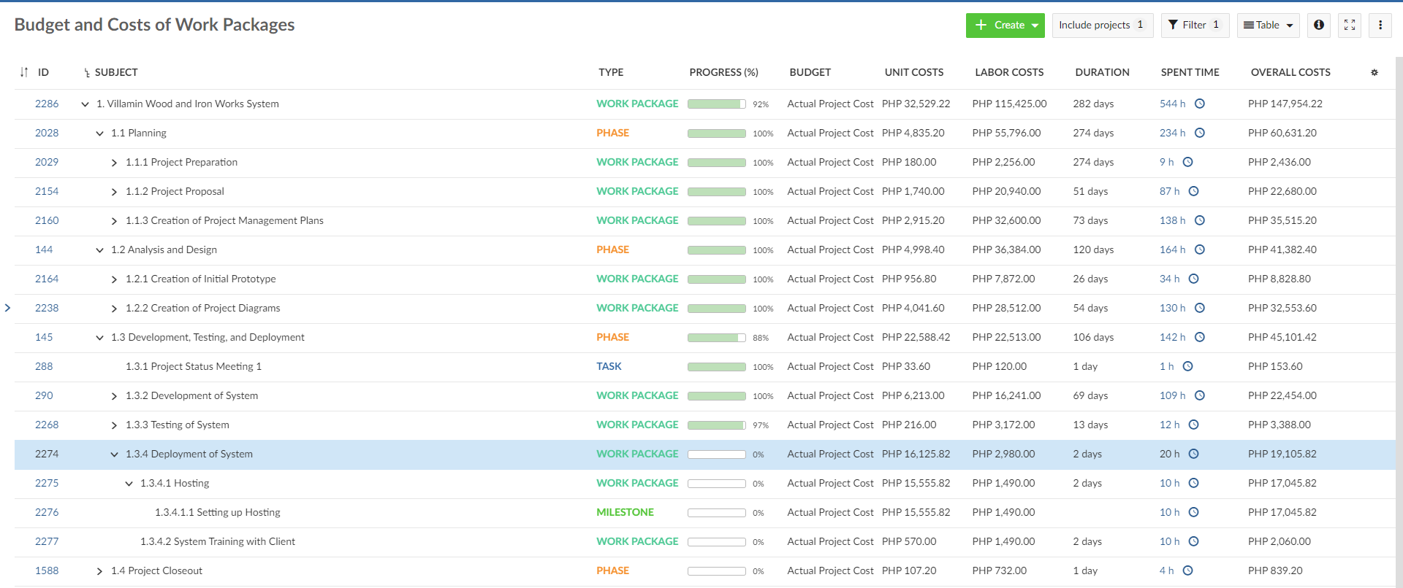
DETAILED COST ESTIMATE
Presented By: Nathaniel Sison

Slide 15

TRANSITION APPROACH
The Villamin Wood and Iron Works System addressed the Transition Plan, in which there will be a phase or transition that should be followed for continuity and to reduce any operational challenges or interruptions that they encounter. This precise and systematic approach enables the transfer of knowledge, resources, and responsibility to the business company, thereby reducing all possible technical interruptions. The transition approach will include the following steps:
Communication Plan
Staffing
Transition Planning
Knowledge Transfer
Presented By: Nathaniel Sison

Slide 16
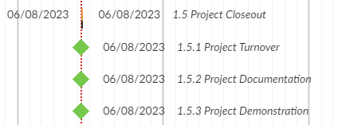
TRANSITION OUT SCHEDULE
Presented By: Nathaniel Sison

Slide 17
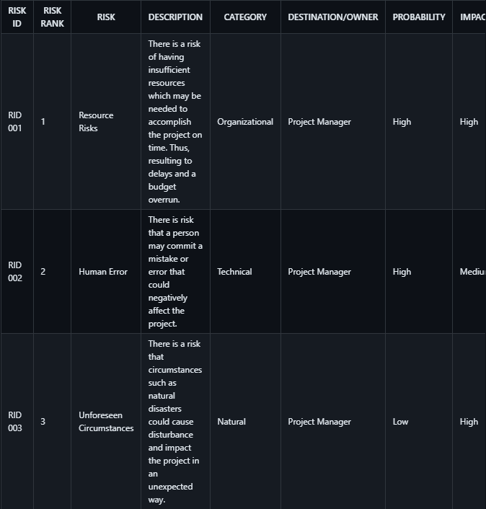
RISK REGISTER
Presented By: Ludwig Angeles

Slide 18
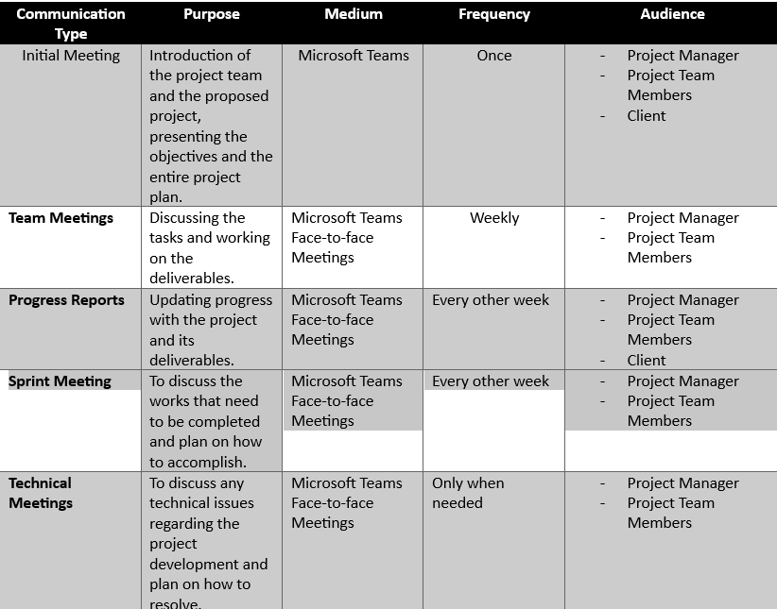
COMMUNICATION MATRIX
Presented By: Ludwig Angeles

Slide 19
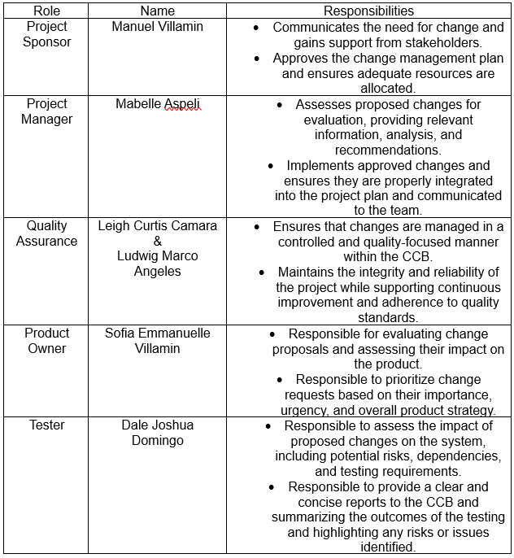
CHANGE CONTROL BOARD
Presented By: Sofia Villamin

Slide 20

MLNSD
THANK
YOU!

Slide 21
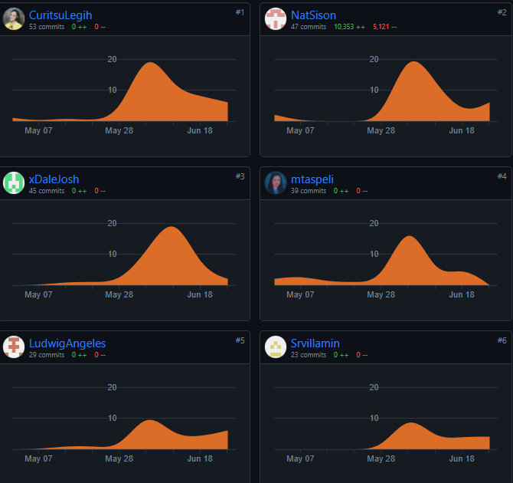
GITHUB REPO CONTRIBUTIONS

Slide 22
Contributor | Contribution
Angeles, Ludwig | Business Case (25%) Implementation Plan (40%) Scope Management Plan (50%) Risk Management Plan (100%) WBS Communication Management Plan (100%) Powerpoint
Aspeli, Mabelle | WBS (100%) PowerPoint Project Management Approach (100%) Work Package Solution (100%) Compiling of 10 Consolidated Project Management Plan WBS Dictionary
Camara, Leigh Curtis | Schedule Management Plan (100%) PowerPoint Business Case (5%) Quality Management Plan (5%) Procurement Plan (100%) Implementation Plan (5%) Staffing Management Plan / Human Resources Management Plan (100%)
Domingo, Dale Joshua | PowerPoint Quality Management Plan (95%) Business Case (30%) Implementation Plan (45%) Scope Management Plan (50%)
Sison, Nathaniel | Cost Management Plan (90%) System Requirements Specification (100%) Business Case (25%) Online System
Villamin, Sofia Emmanuelle | Company Profile (100%) Stakeholder Analysis (100%) Business Case (15%) Stakeholder Management Strategy (100%) Cost Management Plan (10%) Implementation Plan (10%) Change Management Plan (100%)

